Slide 1

Servlets

Slide 2
What is Servlet?
Servlet is a J2EE component
Servlet is a Server side technology, which resides in server.
Servlet is a class that extend the capabilities of the servers and respond to the incoming request. It can respond to any type of requests.
Servlet is a web component that is deployed on the server to create dynamic web page.
Servlet technology is used to create Web Applications.
Servlets are WODA (Write Once Deploy Anywhere) components.
Servlet is an API that provides many interfaces and classes including documentations.
Servlet is an interface that must be implemented for creating any servlet.

Slide 3
What is web application?
A web application is an application accessible from the web.
A web application is composed of web components like Servlet, JSP, Filter etc. and other components such as HTML, CSS, Javascript
The web components typically execute in Web Server and respond to HTTP request.

Slide 4
HTML, CSS, Javascript
HTML is to create Web pages
CSS is to apply styles to the web pages
Java script is to make HTML to DHTHML and to provide client side validations

Slide 5
HTML Tags

Slide 6
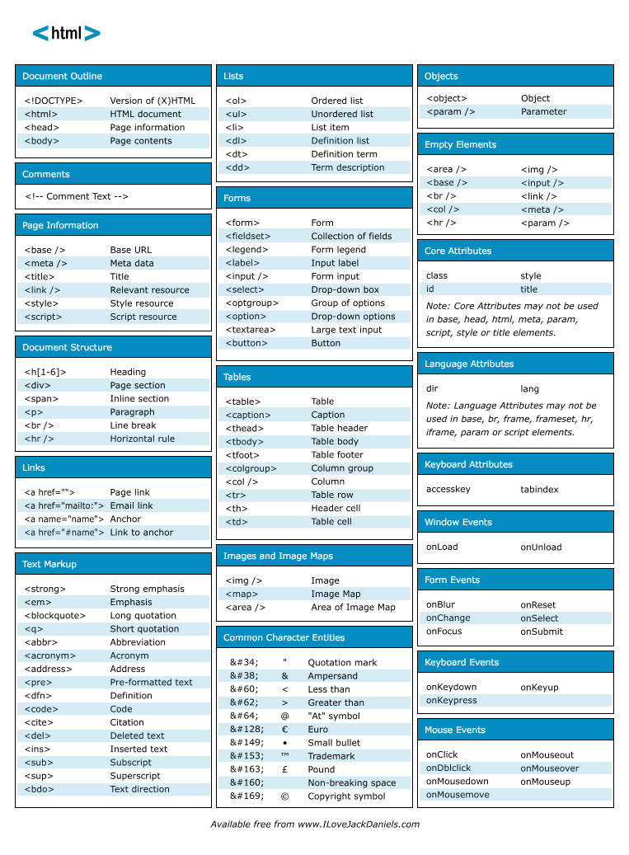

Slide 7
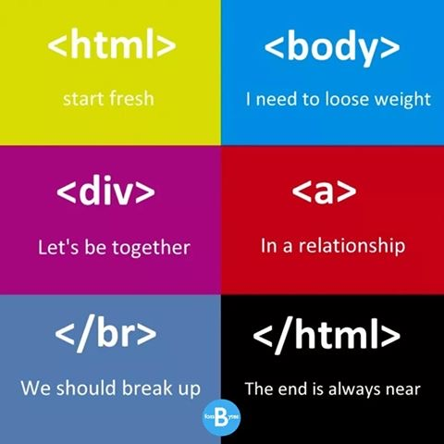
HTML tags

Slide 8
Javascript frameworks
JQuery
Angular JS
Ext JS
Backbone JS
Etc..

Slide 9
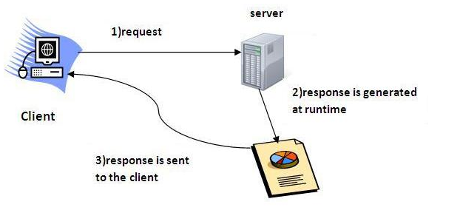
Web-application Flow

Slide 10

Firewall

Slide 11

Web designers Vs developers

Slide 12
CGI(Commmon Gateway Interface)
Before Servlet, CGI (Common Gateway Interface) scripting language was popular as a server-side programming language. But there was many disadvantages of this technology
it starts a new process for every client request

Slide 13
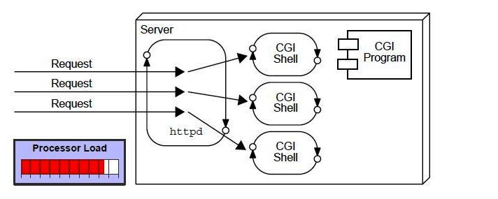
Web Application Flow using CGI

Slide 14
Disadvantages of CGI
If number of clients increases, it takes more time for sending response.
For each request, it starts a process and Web server is limited to start processes.
It uses platform dependent language e.g. C, C++, perl.

Slide 15
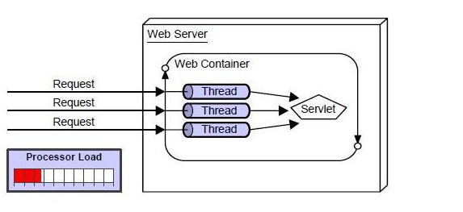
Advantage of Servlet over CGI
The web container creates threads for handling the multiple requests to the servlet. Threads have a lot of benefits over the Processes such as they share a common memory area, lightweight, cost of communication between the threads are low

Slide 16
Basic Benefits of Servlet
better performance: because it creates a thread for each request not process.
Portability: because it uses java language.
Robust: Servlets are managed by JVM so no need to worry about memory leak, garbage collection etc.
Secure: because it uses java language..

Slide 17
Servlet Terminology
HTTP
HTTP Request Types
Difference between Get and Post method
Container
Server and Difference between web server and application server
Content Type
Introduction of XML
Deployment

Slide 18
HTTP (Hyper Text Transfer Protocol)
Http is the protocol that allows web servers and browsers to exchange data over the web.
It is a request response protocol.
Http uses reliable TCP connections by default on TCP port 80.
It is stateless means each request is considered as the new request. In other words, server doesn't recognize the user by default.

Slide 19
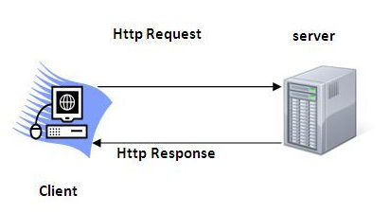
HTTP

Slide 20
Http Request Methods
Every request has a header, that tells the status of the client
GET
POST
HEAD
PUT
DELETE
OPTIONS
TRACE

Slide 21
HTTP Methods usage:
GET - Retrieve Data
POST- Create/Insert Data
PUT- Update Data
DELETE- Delete Data

Slide 22
HTTP Request Methods
HTTP Request | Description
GET | Asks to get the resource at the requested URL.
POST | Asks the server to accept the body info attached. It is like GET request with extra info sent with the request.
HEAD | Asks for only the header part of whatever a GET would return. Just like GET but with no body.
TRACE | Asks for the loopback of the request message, for testing or troubleshooting.
PUT | Says to put the enclosed info (the body) at the requested URL. It’s used for update
DELETE | Says to delete the resource at the requested URL.
OPTIONS | Asks for a list of the HTTP methods to which the thing at the request URL can respond

Slide 23
Note
Get and Post requests are mostly used

Slide 24
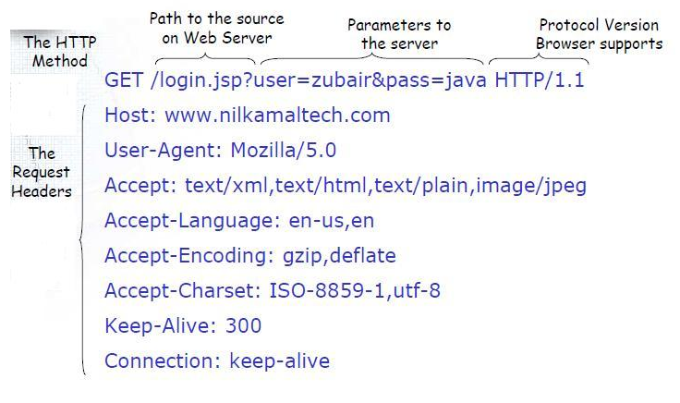
Architecture of of Get Request
data is sent in request header in case of get request, it is the default request type

Slide 25
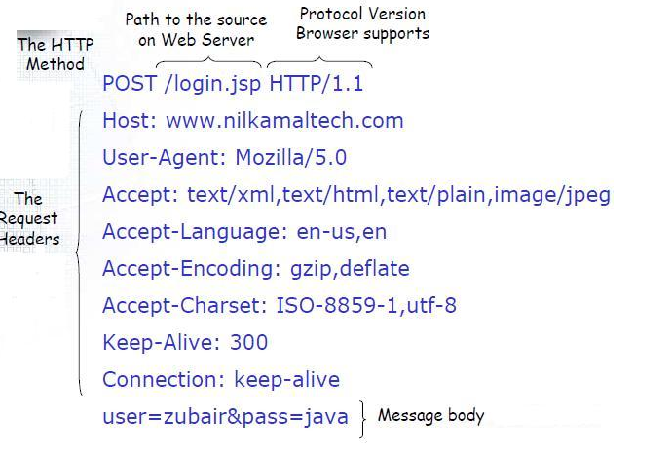
Architecture of Post Request
data is sent in message body

Slide 26
What is the difference between Get and Post?
GET | POST
1) In case of Get request, only limited amount of data can be sent because data is sent in header. | In case of post request, large amount of data can be sent because data is sent in body.
2) Get request is not secured because data is exposed in URL bar. | Post request is secured because data is not exposed in URL bar.
3) Get request can be bookmarked | Post request cannot be bookmarked
4) Get request is idempotent. It means second request will be ignored until response of first request is delivered. | Post request is non-idempotent
5) Get request is more efficient and used more than Post | Post request is less efficient and used less than get.

Slide 27
Container
It provides runtime environment for JavaEE (j2ee) applications.
It performs many operations that are given below:
Life Cycle Management
Multithreaded support
Object Pooling
Security etc.

Slide 28
Server
It is a running program or software that provides services.
There are two types of servers:
Web Server
Application Server

Slide 29
Web Server
Web server contains only web or servlet container. It can be used for servlet, jsp, struts, jsf etc. It can't be used for EJB.
Example of Web Servers are: Apache Tomcat and Resin.

Slide 30
Application Server
Application server contains Web and EJB containers. It can be used for servlet, jsp, struts, jsf, ejb etc.
Example of Application Servers are:
JBoss Open-source server from JBoss community.
Glassfish provided by Sun Microsystem. Now acquired by Oracle.
Weblogic provided by Oracle. It more secured.
Websphere provided by IBM.

Slide 31
MIME
Content Type is also known as MIME (Multipurpose internet Mail Extension) Type. It is a HTTP header that provides the description about what are you sending to the browser.
There are many content types:
text/html
text/plain
application/msword
application/vnd.ms-excel
application/jar
application/pdf
application/octet-stream
application/x-zip
images/jpeg
video/quicktime etc.

Slide 32
Servlet API
The javax.servlet and javax.servlet.http packages represent interfaces and classes for servlet api.
The javax.servlet package contains many interfaces and classes that are used by the servlet or web container. These are not specific to any protocol.
The javax.servlet.http package contains interfaces and classes that are responsible for http requests only.

Slide 33
Interfaces in javax.servlet package
Servlet
ServletRequest
ServletResponse
RequestDispatcher
ServletConfig
ServletContext
SingleThreadModel
Filter
FilterConfig
FilterChain
ServletRequestListener
ServletRequestAttributeListener
ServletContextListener
ServletContextAttributeListener

Slide 34
Classes in javax.servlet package
GenericServlet
ServletInputStream
ServletOutputStream
ServletRequestWrapper
ServletResponseWrapper
ServletRequestEvent
ServletContextEvent
ServletRequestAttributeEvent
ServletContextAttributeEvent
ServletException
UnavailableException

Slide 35
Interfaces in javax.servlet.http package
HttpServletRequest
HttpServletResponse
HttpSession
HttpSessionListener
HttpSessionAttributeListener
HttpSessionBindingListener
HttpSessionActivationListener
HttpSessionContext (deprecated now)

Slide 36
Classes in javax.servlet.http package
HttpServlet
Cookie
HttpServletRequestWrapper
HttpServletResponseWrapper
HttpSessionEvent
HttpSessionBindingEvent
HttpUtils (deprecated now)

Slide 37
Life Cycle of a Servlet (Servlet Life Cycle)
The web container maintains the life cycle of a servlet instance.
Servlet class is loaded.
Servlet instance is created.
init method is invoked.
service method is invoked.
destroy method is invoked.

Slide 38
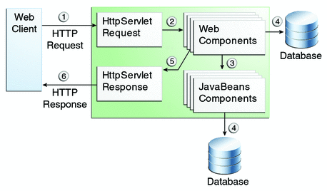
Java Web Application Request Handling

Slide 39
Servlet Life cycle methods
init() - it executes only once
service() - it executes for every request
destroy() - at the end - it executes only once

Slide 40
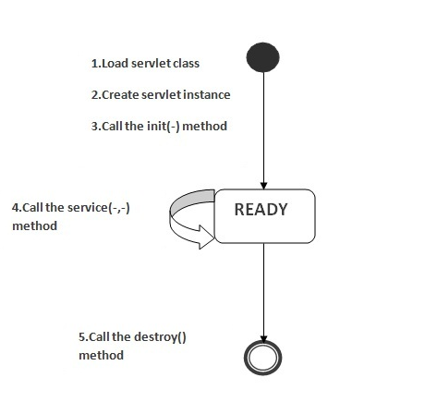
Servlet Life Cycle Flow

Slide 41
States of Servlet
1. new
2. ready
3. end.
The servlet is in new state if servlet instance is created.
After invoking the init() method, Servlet comes in the ready state. In the ready state, servlet performs all the tasks.
When the web container invokes the destroy() method, it shifts to the end state.

Slide 42
1) Servlet class is loaded
The class loader is responsible to load the servlet class. The servlet class is loaded when the first request for the servlet is received by the web container.

Slide 43
2) Servlet instance is created
The web container creates the instance of a servlet after loading the servlet class. The servlet instance is created only once in the servlet life cycle.

Slide 44
3) init method is invoked
The web container calls the init method only once after creating the servlet instance. The init method is used to initialize the servlet. It is the life cycle method of the javax.servlet.Servlet interface.
Syntax
public void init(ServletConfig config) throws ServletException

Slide 45
4) service method is invoked
The web container calls the service method each time when request for the servlet is received. If servlet is not initialized, it follows the first three steps as described above then calls the service method. If servlet is initialized, it calls the service method. Notice that servlet is initialized only once.
Syntax:
public void service(ServletRequest request, ServletResponse response)
throws ServletException, IOException

Slide 46
5) destroy method is invoked
The web container calls the destroy method before removing the servlet instance from the service. It gives the servlet an opportunity to clean up any resource for example memory, thread etc.
Syntax:
public void destroy()

Slide 47
Steps to create a servlet example
Create a directory structure
Create a Servlet
Compile the Servlet
Create a deployment descriptor
Start the server and deploy the project
Access the servlet

Slide 48
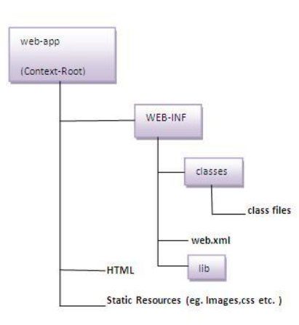
1)Create a directory structures
The directory structure defines that where to put the different types of files so that web container may get the information and respond to the client.
The Sun Microsystem defines a unique standard to be followed by all the server vendors.

Slide 49
Web Application Directory Structure

Slide 50
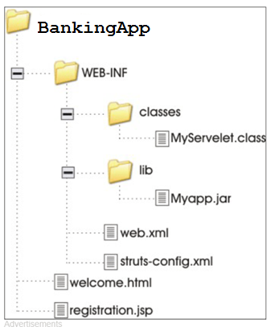
Web App Directory Folder Structure

Slide 51
2. Create a Servlet
There are three ways to create the servlet.
1. By implementing the Servlet interface
2. By inheriting the GenericServlet class
3. By inheriting the HttpServlet class

Slide 52
DemoServlet.java by extending HttpSerlvet
import javax.servlet.http.*;
import javax.servlet.*;
import java.io.*;
public class DemoServlet extends HttpServlet{
public void doGet(HttpServletRequest req,HttpServletResponse res)
throws ServletException,IOException
{
res.setContentType("text/html");//setting the content type
PrintWriter pw=res.getWriter();//get the stream to write the data
//writing html in the stream
pw.println("<html><body>");
pw.println("Welcome to servlet");
pw.println("</body></html>");
pw.close();//closing the stream
}}

Slide 53
3)Compile the servlet
For compiling the Servlet, jar file is required to be loaded. Different Servers provide different jar files:
Jar file | Server
1) servlet-api.jar | Apache Tomcat
2) weblogic.jar | Weblogic
3) javaee.jar | Glassfish
4) javaee.jar | JBoss

Slide 54
Two ways to load the jar file
set classpath or
paste the jar file in JRE/lib/ext folder
Put the java file in any folder. After compiling the java file, paste the class file of servlet in WEB-INF/classes directory.

Slide 55
4)Create the deployment descriptor (web.xml file)
The deployment descriptor is an xml file, from which Web Container gets the information about the servlet to be invoked.
The web container uses the Parser to get the information from the web.xml file. There are many xml parsers such as SAX, DOM and Pull.
There are many elements in the web.xml file.

Slide 56
web.xml file
<web-app>
<servlet>
<servlet-name>s1</servlet-name>
<servlet-class>DemoServlet</servlet-class>
</servlet>
<servlet-mapping>
<servlet-name>s1</servlet-name>
<url-pattern>/welcome</url-pattern>
</servlet-mapping>
</web-app>

Slide 57
Description of the elements of web.xml file
<web-app> represents the whole application.
<servlet> is sub element of <web-app> and represents the servlet.
<servlet-name> is sub element of <servlet> represents the name of the servlet.
<servlet-class> is sub element of <servlet> represents the class of the servlet.
<servlet-mapping> is sub element of <web-app>. It is used to map the servlet.
<url-pattern> is sub element of <servlet-mapping>. This pattern is used at client side to invoke the servlet.

Slide 58
5)Start the Server and deploy the project
To start Apache Tomcat server, double click on the startup.bat file under apache-tomcat/bin directory.

Slide 59
One Time Configuration for Apache Tomcat Server
You need to perform 2 tasks:
set JAVA_HOME or JRE_HOME in environment variable (It is required to start server).
Change the port number of tomcat (optional). It is required if another server is running on same port (8080).

Slide 60
Notes
After setting the JAVA_HOME double click on the startup.bat file in apache tomcat/bin.
Note: There are two types of tomcat available:Apache tomcat that needs to extract only (no need to install) Apache tomcat that needs to install

Slide 61
How to change port number of apache tomcat
Changing the port number is required if there is another server running on the same system with same port number.Suppose you have installed oracle, you need to change the port number of apache tomcat because both have the default port number 8080.
Open server.xml file in notepad. It is located inside the apache-tomcat/conf directory . Change the Connector port = 8080 and replace 8080 by any four digit number instead of 8080. Let us replace it by 9999 and save this file.

Slide 62
5) How to deploy the servlet project
Copy the project and paste it in the webapps folder under apache tomcat.

Slide 63
6. How to access the servlet
Open browser and write http://hostname:portno/contextroot/urlpatternofservlet.
For example:
http://localhost:9999/demo/welcome

Slide 64
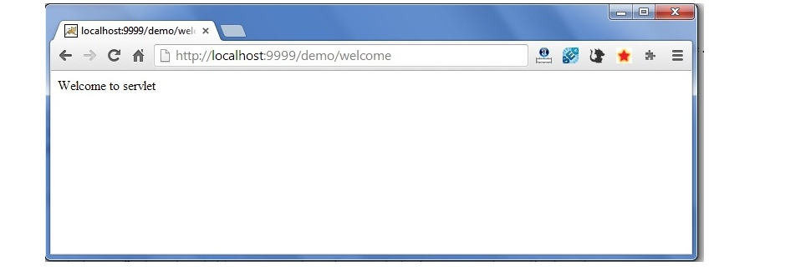
output

Slide 65
Several ways to deploy the project.
By copying the context(project) folder into the webapps directory
By copying the war folder into the webapps directory
By selecting the folder path from the server
By selecting the war file from the server

Slide 66
War File
A war (web archive) File contains files of a web project. It may have servlet, xml, jsp, image, html, css, js etc. files.
web archive (war) file contains all the contents of a web application. It reduces the time duration for transferring file.

Slide 67
How to create war file?
To create war file, you need to use jar tool of JDK. You need to use -c switch of jar, to create the war file.
Go inside the project directory of your project (outside the WEB-INF), then write the following command:
jar -cvf projectname.war *
Here, -c is used to create file, -v to generate the verbose output and -f to specify the arhive file name.
The * (asterisk) symbol signifies that all the files of this directory (including sub directory).

Slide 68
Advantage of war file
saves time: The war file combines all the files into a single unit. So it takes less time while transferring file from client to server.

Slide 69
How to deploy the war file?
There are two ways to deploy the war file
By server console panel
By manually having the war file in specific folder of server.
If you want to deploy the war file in apache tomcat server manually, go to the webapps directory of apache tomcat and paste the war file here.
Now, you are able to access the web project through browser.
Note: server will extract the war file internally.

Slide 70
How to extract war file manually?
To extract the war file, you need to use -x switch of jar tool of JDK. Let's see the command to extract the war file.
jar -xvf projectname.war

Slide 71
Create Servlet Example in Eclipse
Eclipse is an open-source ide for developing JavaSE and JavaEE (J2EE) applications. You can download the eclipse ide from the eclipse website http://www.eclipse.org/downloads/.
You need to download the eclipse ide for JavaEE developers.
Creating servlet example in eclipse ide, saves a lot of work to be done. It is easy and simple to create a servlet example.

Slide 72
Create Servlet Example in Eclipse
Create a Dynamic web project
create a servlet
add servlet-api.jar file
Run the servlet

Slide 73
Configure tomcat server in Eclipse
We will install an Apache Tomcat server using the Server Installed Runtimes preference page.
If you do not have Apache Tomcat on your machine, you will first need to download and unzip Apache Tomcat (this scenario was written using Apache Tomcat version 5.0.28, but other versions can be substituted).
Start the Eclipse WTP workbench.
Open Window -> Preferences -> Server -> Installed Runtimes to create a Tomcat installed runtime.
Click on Add... to open the New Server Runtime dialog, then select your runtime under Apache (Apache Tomcat v5.0 in this example):
Source: https://www.eclipse.org/webtools/jst/components/ws/1.0/tutorials/InstallTomcat/InstallTomcat.html

Slide 74
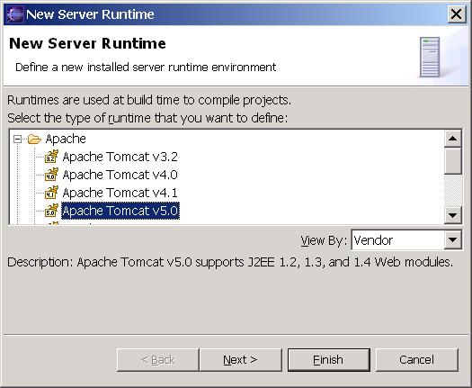
Click Next , and fill in your Tomcat installation directory

Slide 75
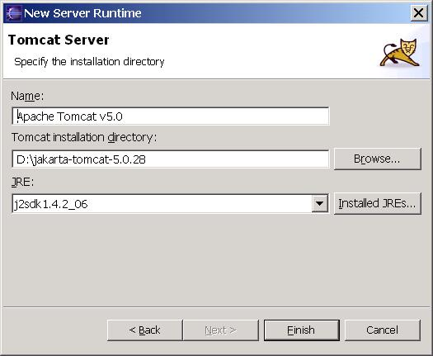
Ensure the selected JRE is a full JDK and is of a version that will satisfy Apache Tomcat (this scenario was written using SUN JDK 1.4.2_06). If necessary, you can click on Installed JREs... to add JDKs to Eclipse. Click Finish

Slide 76
Create Servlet Example in Eclipse Step by Step

Slide 77
The superclass “javax.servlet.http.HttpServlet” was not found on the Java Build Path in eclipse
1) Right click on Project->Properties->Target Runtimes->select server (Apache Tomcat
(or)
2) Right Click on Project->Select Properties->Select Project Facets->Select Apache Tomcat as Runtime server->Click OK
(or)
3) Right click on Project -> Properties-> Java Build Path-> Add Library -> Select "Server Runtime" from the list-> Next->Select "Apache Tomcat"-> Finish
(or)
4) Add servlet-api.jar file to the build path manually
(or)
5) Add below dependency in pom.xml if it is maven project
<dependency>
<groupId>javax.servlet</groupId>
<artifactId>servlet-api</artifactId>
<version>2.5</version>
</dependency>

Slide 78
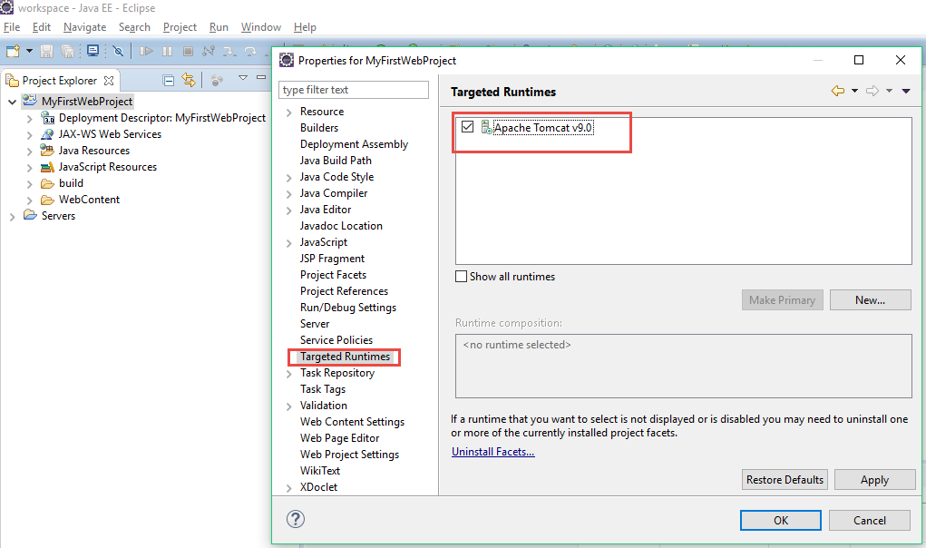
1) Right click on Project->Properties->Target Runtimes->select server (Apache Tomcat)

Slide 79
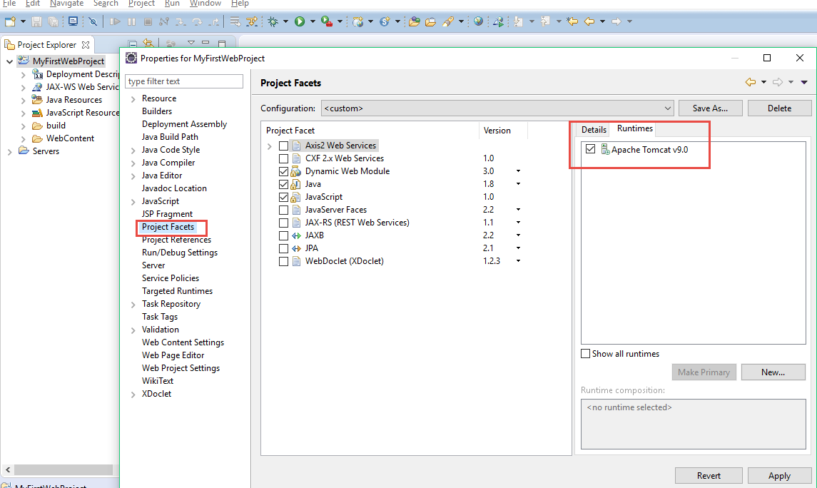
2) Right Click on Project->Select Properties->Select Project Facets->Select Apache Tomcat as Runtime server->Click OK

Slide 80
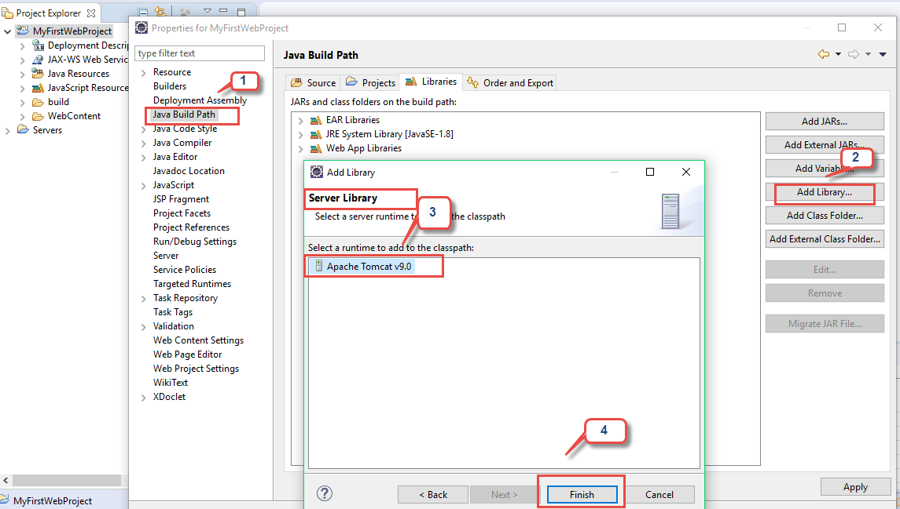
3) Right click on Project -> Properties-> Java Build Path-> Add Library -> Select "Server Runtime" from the list-> Next->Select "Apache Tomcat"-> Finish

Slide 81
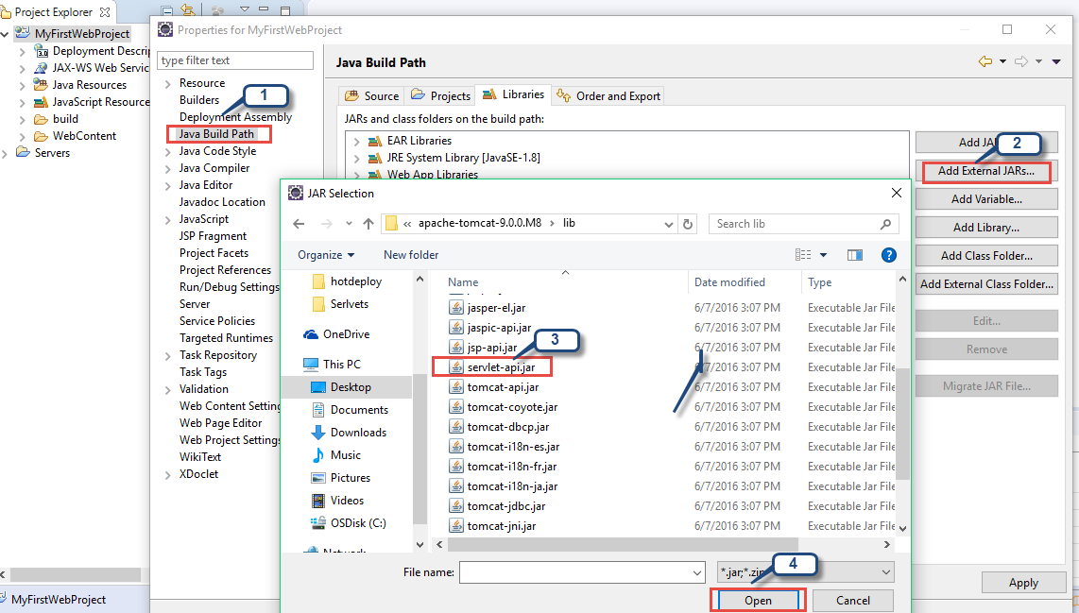
4) Add servlet-api.jar file to the build path manually

Slide 82
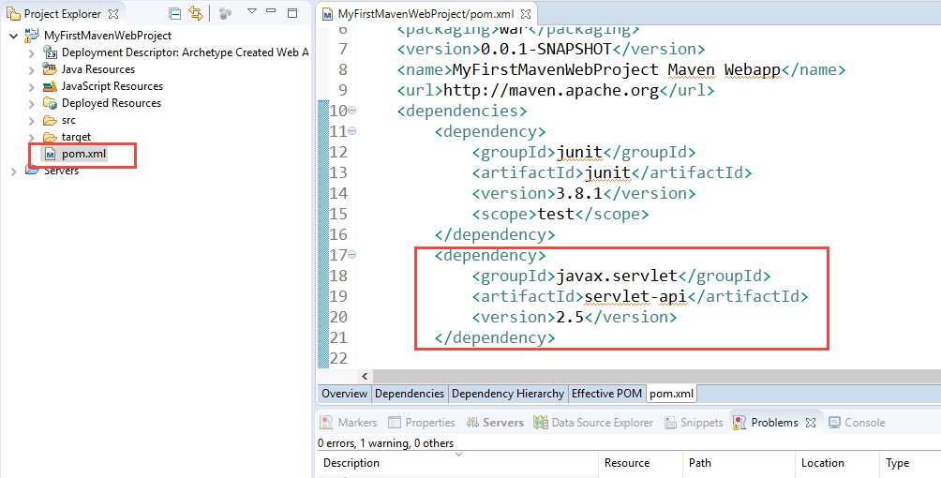
5) For Maven project, Add servlet jar dependency in pom..xml

Slide 83
***Note: For Maven Project in eclipse, check by adding any one of the entries(version specific) in the pom.xml if javax.servlet.http.HttpServlet class not found issue is occurred still after adding server run time to the project
<dependency>
<groupId>javax.servlet</groupId>
<artifactId>javax.servlet-api</artifactId>
<version>3.0.1</version>
<scope>provided</scope>
</dependency>
<dependency>
<groupId>javax.servlet.jsp</groupId>
<artifactId>javax.servlet.jsp-api</artifactId>
<version>2.2.1</version>
<scope>provided</scope>
</dependency>

Slide 84
Note: Maven stuff
<scope>provided</scope> says take the library from the runtime only
Provided scope:
Dependency will be available at run time environment so don't add this dependency in any case
provided dependencies are not packaged

Slide 85
Creating Servlet in My Eclipse IDE
Create a web project
create a servlet
start myeclipse tomcat server and deploy project

Slide 86
Create Servlet Example in My Eclipse step by step

Slide 87
Creating a servlet in NetBeans IDE step by step

Slide 88
How many ways We can create User defined servlet
1. By implementing Servlet interface,
2. By extending GenericServlet class, (or)
3. By extending HttpServlet class

Slide 89
Note
The mostly used approach is by extending HttpServlet because it provides http request specific method such as doGet(), doPost(), doHead() etc.

Slide 90
1. Servlet Interface
Servlet interface provides common behavior to all the servlets.
Servlet interface needs to be implemented for creating any servlet (either directly or indirectly). It provides 3 life cycle methods that are used to initialize the servlet, to service the requests, and to destroy the servlet and 2 non-life cycle methods.

Slide 91
Methods of Servlet interface
The init, service and destroy are the life cycle methods of servlet. These are invoked by the web container.
Method | Description
public void init(ServletConfig config) | initializes the servlet. It is the life cycle method of servlet and invoked by the web container only once.
public void service(ServletRequest request,ServletResponse response) | provides response for the incoming request. It is invoked at each request by the web container.
public void destroy() | is invoked only once and indicates that servlet is being destroyed.
public ServletConfig getServletConfig() | returns the object of ServletConfig.
public String getServletInfo() | returns information about servlet such as writer, copyright, version etc.

Slide 92
1.Create a Servlet by implementing Servlet Interface

Slide 93
public class First implements Servlet{
ServletConfig config=null;
public void init(ServletConfig config){
this.config=config;
System.out.println("servlet is initialized");
}
public void service(ServletRequest req,ServletResponse res)
throws IOException,ServletException{
res.setContentType("text/html");
PrintWriter out=res.getWriter();
out.print("<html><body>");
out.print("<b>hello simple servlet</b>");
out.print("</body></html>");
}
public void destroy(){System.out.println("servlet is destroyed");}
public ServletConfig getServletConfig(){return config;}
public String getServletInfo(){return "copyright 2007-1010";}
}

Slide 94
Drawback
We should provide implementation to the all the methods of Servlet Interface

Slide 95
***Can we call destroy() method inside the init() method is yes what will happen?
Yes we can call like this but if we have not overridden this method container will call the default method and nothing will happen.after calling this if any we have overridden the method then the code written inside is executed.

Slide 96
GenericServlet class

Slide 97
Generic Servlet Class
GenericServlet class implements Servlet, ServletConfig and Serializable interfaces. It provides the implementation of all the methods of these interfaces except the service method.
GenericServlet class can handle any type of request so it is protocol-independent.
You may create a generic servlet by inheriting the GenericServlet class and providing the implementation of the service method.

Slide 98
GenericServlet Methods part-1
public void init(ServletConfig config) is used to initialize the servlet. It internally calls convenience init() method.
public abstract void service(ServletRequest request, ServletResponse response) provides service for the incoming request. It is invoked at each time when user requests for a servlet.
public void destroy() is invoked only once throughout the life cycle and indicates that servlet is being destroyed.
public ServletConfig getServletConfig() returns the object of ServletConfig.
public String getServletInfo() returns information about servlet such as writer, copyright, version etc.
public void init() it is a convenient method for the servlet programmers, now there is no need to call super.init(config)
public ServletContext getServletContext() returns the object of ServletContext.

Slide 99
Generic Servlet Methods part-2
public String getInitParameter(String name) returns the parameter value for the given parameter name.
public Enumeration getInitParameterNames() returns all the parameters defined in the web.xml file.
public String getServletName() returns the name of the servlet object.
public void log(String msg) writes the given message in the servlet log file.
public void log(String msg,Throwable t) writes the explanatory message in the servlet log file and a stack trace.

Slide 100
***Difference between init(config) and init() method
Init(config)
Init()
The default implementation of init(ServletConfig) does some initialization then calls init().
If you use init(ServletConfig) and forget to call super.init(config) at the start of the method then your Servlet will not be initialized correctly.
When overriding init(ServletConfig), the first thing that must be done is to call:
super.init(config);
A convenience method which can be overridden so that there's no need to call super.init(config) . simply override this method
It will be called by GenericServlet.init(ServletConfig config).
ServletConfig object can still be retrieved via getServletConfig().

Slide 101
Scenario 1
@Override
public void init(ServletConfig config) throws ServletException {
//super.init(config);
ServletContext context = getServletContext();
}
Output: It throws Null pointer exception
super.init(ServletConfig) is not called(commented) . As a result, ServletConfig is not stored in the servlet instance, and subsequent calls to getServletConfig will return null.

Slide 102
Why super.init (config) is the first statement inside init(config)
This will be the first statement if we are overriding the init(config) method by this way we will store the config object for future reference and we can use by getServletConfig() to get information about config object if will not do this config object will be lost and we have only one way to get config object because servlet pass config object only in init method . Without doing this if we call the ServletConfig method will get NullPointerException.

Slide 103
Scenario 2
@Override
public void init() throws ServletException {
ServletContext context = getServletContext();
}
Output: No Nullpointer exception
init() method is called internally from init(ServletConfig config) method.
So here no need to call super init(config) method

Slide 104
Constructor vs Init method in Servlet - JEE Interview Question
Can we have a Constructor in Java Servlet?
or
Why do we need constructor in Servlet if there is already an init() method for initializing Servlet?
or
What is difference between init() method and constructor in Servlet?
Or

Slide 105
Can we define Constructor in Servlet?
Yes, Servlet implementation classes can have constructor but they should be using init() method to initialize
Servlet because of two reasons,
first you cannot declare constructors on interface in Java
second, Servlet requires ServletConfig object for initialization which is created by container as it also has reference of ServletContext object, which is also created by container.
if you don't provide an explicit constructor than compiler will add a default no argument constructor in any Servlet implementation class. Another reason that you should not initialize Servlet using constructor because Servlets are not directly instantiated by Java code, instead container creates there instance and keeps them in pool.
Always prefer init() method for initializing Servlet than constructor, because ServletConfig object is supplied to init() method with configuration parameters.

Slide 106
Since containers from web servers like Tomcat and Jetty uses Java Reflection for creating instance of Servlet, presence of no argument constructor is must. So, by any chance if you provide a parametric constructor and forget to write a no argument constructor, web container will not be able to create instance of your Servlet, since there is no default constructor. Remember Java compiler doesn't add default no argument constructor, if there is a parametric constructor presents in class. That's why it's not advised to provide constructor in Servlet class.

Slide 107
For initializing a servlet can we use a constructor in place of init()
No, we can not use constructor for initializing a servlet because for initialization we need an object of servletConfig using this object we get all the parameter which are defined in deployment descriptor for initializing a servlet and in servlet class we have only default constructor according to older version of java so if we want to pass a Config object we don’t have parametrized constructor and apart from this servlet is loaded and initialized by container so it's a job of container to call the method according to servlet specification they have lifecycle method so init() method is called firstly

Slide 108
2. Servlet Example by extending the GenericServlet class
public class First extends GenericServlet{
public void service(ServletRequest req,ServletResponse res)
throws IOException,ServletException{
res.setContentType("text/html");
PrintWriter out=res.getWriter();
out.print("<html><body>");
out.print("<b>hello generic servlet</b>");
out.print("</body></html>");

Slide 109
3. HttpServlet class
The HttpServlet class extends the GenericServlet class and implements Serializable interface. It provides http specific methods such as doGet, doPost, doHead, doTrace etc.

Slide 110
Methods of HTTP Servlet
public void service(ServletRequest req,ServletResponse res) dispatches the request to the protected service method by converting the request and response object into http type.
protected void service(HttpServletRequest req, HttpServletResponse res) receives the request from the service method, and dispatches the request to the doXXX() method depending on the incoming http request type.
protected void doGet(HttpServletRequest req, HttpServletResponse res) handles the GET request. It is invoked by the web container.
protected void doPost(HttpServletRequest req, HttpServletResponse res) handles the POST request. It is invoked by the web container.

Slide 111
Methods of HTTP Servlet
protected void doHead(HttpServletRequest req, HttpServletResponse res) handles the HEAD request. It is invoked by the web container.
protected void doOptions(HttpServletRequest req, HttpServletResponse res) handles the OPTIONS request. It is invoked by the web container.
protected void doPut(HttpServletRequest req, HttpServletResponse res) handles the PUT request. It is invoked by the web container.
protected void doTrace(HttpServletRequest req, HttpServletResponse res) handles the TRACE request. It is invoked by the web container.
protected void doDelete(HttpServletRequest req, HttpServletResponse res) handles the DELETE request. It is invoked by the web container.
protected long getLastModified(HttpServletRequest req) returns the time when HttpServletRequest was last modified since midnight January 1, 1970 GMT.

Slide 112
3. Creating Servlet by extending HttpServlet
public class DemoServlet extends HttpServlet{
public void doGet(HttpServletRequest req, HttpServletResponse res) throws ServletException, IOException{
res.setContentType("text/html");
PrintWriter pw = res.getWriter();
pw.println("<html><body bgcolor='green'>");
pw.println("Welcome to First servlet program");
pw.println("</body></html>");
}//doGet method ends here
}

Slide 113
How Servlet works?
The server checks if the servlet is requested for the first time.
If yes, web container does the following tasks:
loads the servlet class.
instantiates the servlet class.
calls the init method passing the ServletConfig object
else
calls the service method passing request and response objects
The web container calls the destroy method when it needs to remove the servlet such as at time of stopping server or un-deploying the project.

Slide 114
How web container handles the servlet request?
The web container is responsible to handle the request.
maps the request with the servlet in the web.xml file.
creates request and response objects for this request
calls the service method on the thread
The public service method internally calls the protected service method
The protected service method calls the doGet method depending on the type of request.
The doGet method generates the response and it is passed to the client.
After sending the response, the web container deletes the request and response objects. The thread is contained in the thread pool or deleted depends on the server implementation.

Slide 115
What is written inside the public service method?

Slide 116
Public service method internal code
public void service(ServletRequest req, ServletResponse res)
throws ServletException, IOException
{
HttpServletRequest request;
HttpServletResponse response;
try
{
request = (HttpServletRequest)req;
response = (HttpServletResponse)res;
}
catch(ClassCastException e)
{
throw new ServletException("non-HTTP request or response");
}
service(request, response);
}

Slide 117
What is written inside the protected service method?
The protected service method checks the type of request, if request type is get, it calls doGet method, if request type is post, it calls doPost method, so on.

Slide 118
Protected service method internal code
protected void service(HttpServletRequest req, HttpServletResponse resp)
throws ServletException, IOException
{
String method = req.getMethod();
if(method.equals("GET"))
{
long lastModified = getLastModified(req);
if(lastModified == -1L)
{
doGet(req, resp);
}
....
//rest of the code
}
}

Slide 119
welcome-file-list in web.xml
The welcome-file-list element of web-app, is used to define a list of welcome files. Its sub element is welcome-file that is used to define the welcome file.
A welcome file is the file that is invoked automatically by the server, if you don't specify any file name.
By default server looks for the welcome file in following order:
welcome-file-list in web.xml
index.html
index.htm
index.jsp
If none of these files are found, server renders 404 error.
If you have specified welcome-file in web.xml, and all the files index.html, index.htm and index.jsp exists, priority goes to welcome-file.
If welcome-file-list entry doesn't exist in web.xml file, priority goes to index.html file then index.htm and at last index.jsp file.

Slide 120
web.xml example
<web-app>
....
<welcome-file-list>
<welcome-file>home.html</welcome-file>
<welcome-file>default.html</welcome-file>
</welcome-file-list>
</web-app>
Now, home.html and default.html will be the welcome files.
If you have the welcome file, you can directory invoke the project as given below:
http://localhost:8888/myproject
As you can see, we have not specified any file name after the project.

Slide 121
load on startup in web.xml
The load-on-startup element of web-app loads the servlet at the time of deployment or server start if value is positive. It is also known as pre initialization of servlet.
You can pass positive and negative value for the servlet.

Slide 122
Advantage of load-on-startup element
As you know well, servlet is loaded at first request. That means it consumes more time at first request. If you specify the load-on-startup in web.xml, servlet will be loaded at project deployment time or server start. So, it will take less time for responding to first request.

Slide 123
Passing positive value
If you pass the positive value, the lower integer value servlet will be loaded before the higher integer value servlet. In other words, container loads the servlets in ascending integer value. The 0 value will be loaded first then 1, 2, 3 and so on.

Slide 124
web.xml
<web-app>
....
<servlet>
<servlet-name>servlet1</servlet-name>
<servlet-class>com.mangaraoit.FirstServlet</servlet-class>
<load-on-startup>0</load-on-startup>
</servlet>
<servlet>
<servlet-name>servlet2</servlet-name>
<servlet-class>com.mangaraoit.SecondServlet</servlet-class>
<load-on-startup>1</load-on-startup>
</servlet>
...
</web-app>

Slide 125
Note
There are defined 2 servlets, both servlets will be loaded at the time of project deployment or server start. But, servlet1 will be loaded first then servlet2.

Slide 126
Passing negative value
If you pass the negative value, servlet will be loaded at request time, at first request.

Slide 127
ServletRequest Interface
An object of ServletRequest is used to provide the client request information to a servlet such as content type, content length, parameter names and values, header informations, attributes etc.

Slide 128
HTTP status codes
Contents
1 1xx Informational.
2 2xx Success.
3 3xx Redirection.
4 4xx Client Error.
5 5xx Server Error.
6 Unofficial codes. 6.1 Internet Information Services. 6.2 nginx. 6.3 CloudFlare.

Slide 129
Link for more info about status codes
https://en.wikipedia.org/wiki/List_of_HTTP_status_codes

Slide 130
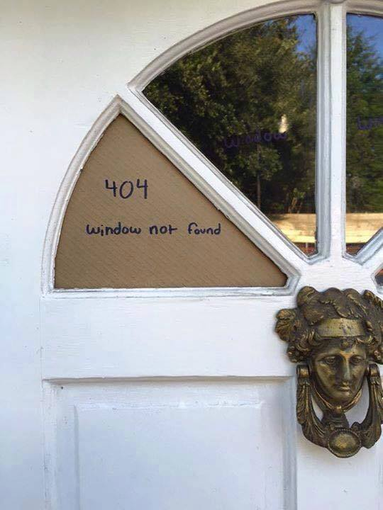

Slide 131
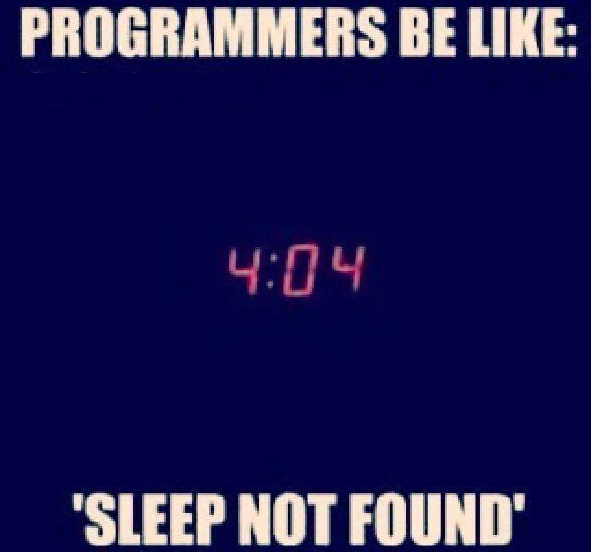
404 Error code

Slide 132

Back-end vs Front-end

Slide 133
Some Methods of ServletRequest interface
Method | Description
public String getParameter(String name) | is used to obtain the value of a parameter by name.
public String[] getParameterValues(String name) | returns an array of String containing all values of given parameter name. It is mainly used to obtain values of a Multi select list box.
java.util.Enumeration getParameterNames() | returns an enumeration of all of the request parameter names.
public int getContentLength() | Returns the size of the request entity data, or -1 if not known.
public String getCharacterEncoding() | Returns the character set encoding for the input of this request.
public String getContentType() | Returns the Internet Media Type of the request entity data, or null if not known.
public ServletInputStream getInputStream() throws IOException | Returns an input stream for reading binary data in the request body.
public abstract String getServerName() | Returns the host name of the server that received the request.
public int getServerPort() | Returns the port number on which this request was received.

Slide 134
Example of ServletRequest to display the name of the user
In this example, we are displaying the name of the user in the servlet. For this purpose, we have used the getParameter method that returns the value for the given request parameter name.

Slide 135
index.html
<form action="welcome" method="get">
Enter your name<input type="text" name="name"><br>
<input type="submit" value="login">
</form>

Slide 136
WelcomeServlet.java
import javax.servlet.http.*;
import javax.servlet.*;
import java.io.*;
public class DemoServ extends HttpServlet{
public void doGet(HttpServletRequest req,HttpServletResponse res)
throws ServletException,IOException
{
res.setContentType("text/html");
PrintWriter pw=res.getWriter();
String name=req.getParameter("name");//will return value
pw.println("Welcome "+name);
pw.close();
}}

Slide 137
RequestDispatcher in Servlet

Slide 138
RequestDispatcher
The RequestDispatcher interface provides the facility of dispatching the request to another resource it may be html, servlet or jsp. This interface can also be used to include the content of another resource also. It is one of the way of servlet collaboration.

Slide 139
Methods of RequestDispatcher interface
public void forward(ServletRequest request,ServletResponse response)throws ServletException,java.io.IOException:Forwards a request from a servlet to another resource (servlet, JSP file, or HTML file) on the server.
public void include(ServletRequest request,ServletResponse response)throws ServletException,java.io.IOException:Includes the content of a resource (servlet, JSP page, or HTML file) in the response.

Slide 140
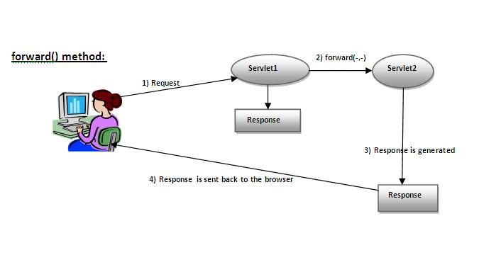
forward() method

Slide 141
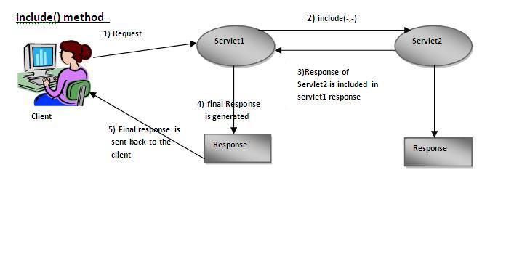
include() method

Slide 142
How to get the object of RequestDispatcher
The getRequestDispatcher() method of ServletRequest interface returns the object of RequestDispatcher.

Slide 143
Syntax of getRequestDispatcher method
RequestDispatcher getRequestDispatcher(String args);

Slide 144
Example of using getRequestDispatcher method
RequestDispatcher rd=request.getRequestDispatcher("servlet2");
//servlet2 is the url-pattern of the second servlet
rd.forward(request, response);//method may be include or forward

Slide 145
Example of RequestDispatcher interface
In this example, we are validating the password entered by the user. If password is servlet, it will forward the request to the WelcomeServlet, otherwise will show an error message: sorry username or password error!. In this program, we are cheking for hardcoded information. But you can check it to the database also that we will see in the development chapter. In this example, we have created following files:
index.html file: for getting input from the user.
ValidateLogin.file: a servlet class for processing the response. If password is servet, it will forward the request to the welcome servlet.
WelcomeServlet.java file: a servlet class for displaying the welcome message.
web.xml file: a deployment descriptor file that contains the information about the servlet.

Slide 146
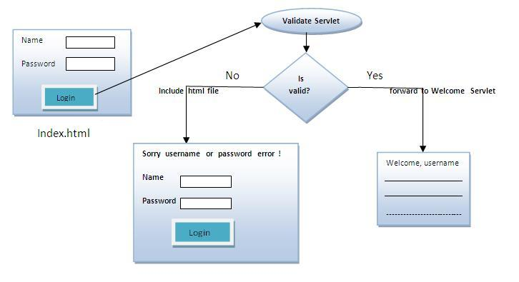
Login Application

Slide 147
Index.html
<form action="servlet1" method="post">
Name:<input type="text" name="userName"/><br/>
Password:<input type="password" name="userPass"/><br/>
<input type="submit" value="login"/>
</form>

Slide 148
ValidateLogin.java
public class ValidateLogin extends HttpServlet {
public void doPost(HttpServletRequest request, HttpServletResponse response)
throws ServletException, IOException {
response.setContentType("text/html");
PrintWriter out = response.getWriter();
String n=request.getParameter("userName");
String p=request.getParameter("userPass");
if(p.equals("servlet"){
RequestDispatcher rd=request.getRequestDispatcher("servlet2");
rd.forward(request, response);
}
else{
out.print("Sorry UserName or Password Error!");
RequestDispatcher rd=request.getRequestDispatcher("/index.html");
rd.include(request, response);
}
}
}

Slide 149
WelcomeServlet.java
public class WelcomeServlet extends HttpServlet {
public void doPost(HttpServletRequest request, HttpServletResponse response)
throws ServletException, IOException {
response.setContentType("text/html");
PrintWriter out = response.getWriter();
String n=request.getParameter("userName");
out.print("Welcome "+n);
}
}

Slide 150
Web.xml
<web-app>
<servlet>
<servlet-name>Login</servlet-name>
<servlet-class>ValidateLogin</servlet-class>
</servlet>
<servlet>
<servlet-name>WelcomeServlet</servlet-name>
<servlet-class>WelcomeServlet</servlet-class>
</servlet>
<servlet-mapping>
<servlet-name>Login</servlet-name>
<url-pattern>/servlet1</url-pattern>
</servlet-mapping>
<servlet-mapping>
<servlet-name>WelcomeServlet</servlet-name>
<url-pattern>/servlet2</url-pattern>
</servlet-mapping>
<welcome-file-list>
<welcome-file>index.html</welcome-file>
</welcome-file-list>
</web-app>

Slide 151
Difference between ServletRequest.getRequestDispatcher and ServletContext.getRequestDispatcher
ServletRequest.getRequestDispatcher() is taking the relative path of the url as argument (Ex- /home.jsp)
request.getRequestDispatcher("/home.jsp");t/home.jsp");
ServletContext.getRequestDispatcher() is taking the absolute path of the url as argument. (Ex- /MyPackage/home.jsp)
getServletContext().getRequestDispatcher("/ContextRoot/home.jsp");
It is for chainig two web applications with in the same server/two different servers

Slide 152
SendRedirect in servlet
SendRedirect

Slide 153
SendRedirect
The sendRedirect() method of HttpServletResponse interface can be used to redirect response to another resource, it may be servlet, jsp or html file.
It accepts relative as well as absolute URL.
It works at client side because it uses the url bar of the browser to make another request. So, it can work inside and outside the server.

Slide 154
How can we invoke another servlet in a different application?
We can’t use RequestDispatcher to invoke servlet from another application because it’s specific for the application. If we have to forward the request to a resource in another application, we can use ServletResponse sendRedirect() method and provide complete URL of another servlet. This sends the response to client with response code as 302 to forward the request to another URL. If we have to send some data also, we can use cookies that will be part of the servlet response and sent in the request to another servlet.

Slide 155
Difference between forward() and sendRedirect() method
forward() method | sendRedirect() method
The forward() method works at server side. | The sendRedirect() method works at client side.
It sends the same request and response objects to another servlet. | It always sends a new request.
It can work within the server only. | It can be used within and outside the server.
Example: request.getRequestDispacher("servlet2").forward(request,response); | Example: response.sendRedirect("servlet2");

Slide 156
Syntax of sendRedirect() method
public void sendRedirect(String URL)throws IOException;

Slide 157
Example of sendRedirect() method
response.sendRedirect("http://www.oracle.com");

Slide 158
Full example of sendRedirect method in servlet
we are redirecting the request to the google server. Notice that sendRedirect method works at client side, that is why we can our request to anywhere. We can send our request within and outside the server.

Slide 159
DemoServlet.java
import java.io.*;
import javax.servlet.*;
import javax.servlet.http.*;
public class DemoServlet extends HttpServlet{
public void doGet(HttpServletRequest req,HttpServletResponse res)
throws ServletException,IOException
{
res.setContentType("text/html");
PrintWriter pw=res.getWriter();
response.sendRedirect("http://www.google.com");
pw.close();
}}

Slide 160
Creating custom google search using sendRedirect
we are using sendRedirect method to send request to google server with the request data.

Slide 161
index.html
<!DOCTYPE html>
<html>
<head>
<meta charset="ISO-8859-1">
<title>sendRedirect example</title>
</head>
<body>
<form action="MySearcher">
<input type="text" name="name">
<input type="submit" value="Google Search">
</form>
</body>
</html>

Slide 162
MySearcher.java
public class MySearcher extends HttpServlet {
protected void doGet(HttpServletRequest request, HttpServletResponse response)
throws ServletException, IOException {
String name=request.getParameter("name");
response.sendRedirect("https://www.google.co.in/#q="+name);
}
}

Slide 163
ServletConfig Interface

Slide 164
ServletConfig
An object of ServletConfig is created by the web container for each servlet.
This object can be used to get configuration information from web.xml file.
If the configuration information is modified from the web.xml file, we don't need to change the servlet. So it is easier to manage the web application if any specific content is modified from time to time.

Slide 165
Advantage of ServletConfig
The core advantage of ServletConfig is that you don't need to edit the servlet file if information is modified from the web.xml file.

Slide 166
Methods of ServletConfig interface
public String getInitParameter(String name):Returns the parameter value for the specified parameter name.
public Enumeration getInitParameterNames():Returns an enumeration of all the initialization parameter names.
public String getServletName():Returns the name of the servlet.
public ServletContext getServletContext():Returns an object of ServletContext.

Slide 167
How to get the object of ServletConfig
getServletConfig() method of Servlet interface returns the object of ServletConfig.

Slide 168
Syntax of getServletConfig() method
public ServletConfig getServletConfig();

Slide 169
Example of getServletConfig() method
ServletConfig config=getServletConfig();
//Now we can call the methods of ServletConfig interface

Slide 170
Syntax to provide the initialization parameter for a servlet
<web-app>
<servlet>
......
<init-param>
<param-name>parametername</param-name>
<param-value>parametervalue</param-value>
</init-param>
......
</servlet>
</web-app>

Slide 171
Example of ServletConfig to get initialization parameter
public class DemoServlet extends HttpServlet {
public void doGet(HttpServletRequest request, HttpServletResponse response)
throws ServletException, IOException {
response.setContentType("text/html");
PrintWriter out = response.getWriter();
ServletConfig config=getServletConfig();
String driver=config.getInitParameter("driver");
out.print("Driver is: "+driver);
out.close();
}
}

Slide 172
web.xml
<web-app>
<servlet>
<servlet-name>DemoServlet</servlet-name>
<servlet-class>DemoServlet</servlet-class>
<init-param>
<param-name>driver</param-name>
<param-value>sun.jdbc.odbc.JdbcOdbcDriver</param-value>
</init-param>
</servlet>
<servlet-mapping>
<servlet-name>DemoServlet</servlet-name>
<url-pattern>/servlet1</url-pattern>
</servlet-mapping>
</web-app>

Slide 173
Example of ServletConfig to get all the initialization parameters
public void doGet(HttpServletRequest request, HttpServletResponse response)
throws ServletException, IOException {
response.setContentType("text/html");
PrintWriter out = response.getWriter();
ServletConfig config=getServletConfig();
Enumeration<String> e=config.getInitParameterNames();
String str="";
while(e.hasMoreElements()){
str=e.nextElement();
out.print("<br>Name: "+str);
out.print(" value: "+config.getInitParameter(str));
}
out.close();

Slide 174
Web.xml
<servlet>
<servlet-name>DemoServlet</servlet-name>
<servlet-class>DemoServlet</servlet-class>
<init-param>
<param-name>username</param-name>
<param-value>system</param-value>
</init-param>
<init-param>
<param-name>password</param-name>
<param-value>oracle</param-value>
</init-param>
</servlet>

Slide 175
Servlet Context Interface

Slide 176
ServletContext Interface
An object of ServletContext is created by the web container at time of deploying the project.
This object can be used to get configuration information from web.xml file.
There is only one ServletContext object per web application.
If any information is shared to many servlet, it is better to provide it from the web.xml file using the <context-param> element.

Slide 177
Advantage of ServletContext
Easy to maintain if any information is shared to all the servlet, it is better to make it available for all the servlet.
We provide this information from the web.xml file, so if the information is changed, we don't need to modify the servlet. Thus it removes maintenance problem.

Slide 178
Usage of ServletContext Interface
The object of ServletContext provides an interface between the container and servlet.
The ServletContext object can be used to get configuration information from the web.xml file.
The ServletContext object can be used to set, get or remove attribute from the web.xml file.
The ServletContext object can be used to provide inter-application communication.

Slide 179
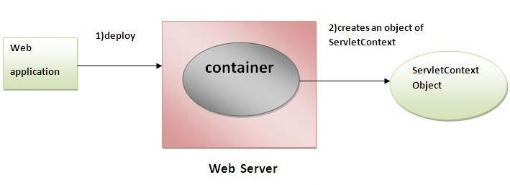

Slide 180
Commonly used methods of ServletContext interface
public String getInitParameter(String name):Returns the parameter value for the specified parameter name.
public Enumeration getInitParameterNames():Returns the names of the context's initialization parameters.
public void setAttribute(String name,Object object):sets the given object in the application scope.
public Object getAttribute(String name):Returns the attribute for the specified name.
public Enumeration getInitParameterNames():Returns the names of the context's initialization parameters as an Enumeration of String objects.
public void removeAttribute(String name):Removes the attribute with the given name from the servlet context.

Slide 181
How to get the object of ServletContext interface
getServletContext() method of ServletConfig interface returns the object of ServletContext.
getServletContext() method of GenericServlet class returns the object of ServletContext.

Slide 182
Syntax of getServletContext() method
public ServletContext getServletContext()

Slide 183
Example of getServletContext() method
//We can get the ServletContext object from ServletConfig object
ServletContext application=getServletConfig().getServletContext();
//Another convenient way to get the ServletContext object
ServletContext application=getServletContext();

Slide 184
Syntax to provide the initialization parameter in Context scope
<web-app>
......
<context-param>
<param-name>parametername</param-name>
<param-value>parametervalue</param-value>
</context-param>
......
</web-app>

Slide 185
Notes
The object of ServletContext represents the application scope.
So if we change the value of the parameter from the web.xml file, all the servlet classes will get the changed value.
So we don't need to modify the servlet. So it is better to have the common information for most of the servlets in the web.xml file by context-param element.

Slide 186
Example of ServletContext to get the initialization parameter
public void doGet(HttpServletRequest req,HttpServletResponse res)
throws ServletException,IOException
{
res.setContentType("text/html");
PrintWriter pw=res.getWriter();
//creating ServletContext object
ServletContext context=getServletContext();
//Getting the value of the initialization parameter and printing it
String driverName=context.getInitParameter("dname");
pw.println("driver name is="+driverName);
pw.close();
}

Slide 187
web.xml
<web-app>
<servlet>
<servlet-name>sonoojaiswal</servlet-name>
<servlet-class>DemoServlet</servlet-class>
</servlet>
<context-param>
<param-name>dname</param-name>
<param-value>sun.jdbc.odbc.JdbcOdbcDriver</param-value>
</context-param>
<servlet-mapping>
<servlet-name>sonoojaiswal</servlet-name>
<url-pattern>/context</url-pattern>
</servlet-mapping>
</web-app>

Slide 188
Attribute

Slide 189
Attribute
An attribute in servlet is an object that can be set, get or removed from one of the following scope:
1. request scope
2. session scope
3. application scope
The servlet programmer can pass informations from one servlet to another using attributes. It is just like passing object from one class to another so that we can reuse the same object again and again.

Slide 190
Attribute specific methods of ServletRequest, HttpSession and ServletContext interface
public void setAttribute(String name, Object object):sets the given object in the application scope.
public Object getAttribute(String name):Returns the attribute for the specified name.
public Enumeration getInitParameterNames():Returns the names of the context's initialization parameters as an Enumeration of String objects.
public void removeAttribute(String name):Removes the attribute with the given name from the servlet context.

Slide 191
Example of ServletContext to set and get attribute

Slide 192
DemoServlet1
public void doGet(HttpServletRequest req,HttpServletResponse res)
{
try{
res.setContentType("text/html");
PrintWriter out=res.getWriter();
ServletContext context=getServletContext();
context.setAttribute("company","IBM");
out.println("Welcome to first servlet");
out.println("<a href='servlet2'>visit</a>");
out.close();
}catch(Exception e){out.println(e);}
}

Slide 193
DemoServlet2
public void doGet(HttpServletRequest req,HttpServletResponse res)
{
try{
res.setContentType("text/html");
PrintWriter out=res.getWriter();
ServletContext context=getServletContext();
String n=(String)context.getAttribute("company");
out.println("Welcome to "+n);
out.close();
}catch(Exception e){out.println(e);}
}

Slide 194
***Difference between ServletConfig and ServletContext
The servletconfig object refers to the single servlet whereas
servletcontext object refers to the whole web application.

Slide 195
Session Tracking in Servlets

Slide 196
Session Tracking
Session simply means a particular interval of time.
Session Tracking is a way to maintain state (data) of an user. It is also known as session management in servlet.
Http protocol is a stateless so we need to maintain state using session tracking techniques. Each time user requests to the server, server treats the request as the new request. So we need to maintain the state of an user to recognize to particular user.

Slide 197
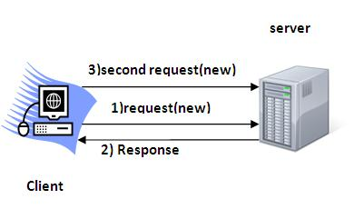
HTTP is stateless that means each request is considered as the new request. It is shown in the figure given below:

Slide 198
Why use Session Tracking?
To recognize the user It is used to recognize the particular user.

Slide 199
Session Tracking Techniques
Cookies
Hidden Form Field
URL Rewriting
HttpSession

Slide 200
Cookies in Servlet

Slide 201
Cookie
A cookie is a small piece of information that is persisted between the multiple client requests.
A cookie has a name, a single value, and optional attributes such as a comment, path and domain qualifiers, a maximum age, and a version number.

Slide 202
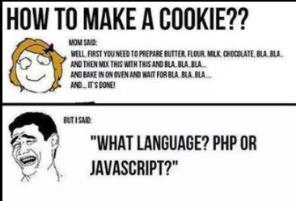
Funny pic

Slide 203
How Cookie works
By default, each request is considered as a new request. In cookies technique, we add cookie with response from the servlet. So cookie is stored in the cache of the browser.
After that if request is sent by the user, cookie is added with request by default. Thus, we recognize the user as the old user.

Slide 204
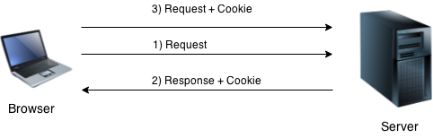

Slide 205
Types of Cookies
Non-persistent cookie
Persistent cookie
It is valid for single session only. It is removed each time when user closes the browser.
It is valid for multiple session . It is not removed each time when user closes the browser. It is removed only if user logout or signout.

Slide 206
Advantage of Cookies
Simplest technique of maintaining the state.
Cookies are maintained at client side.

Slide 207
Disadvantage of Cookies
It will not work if cookie is disabled from the browser.
Only textual information can be set in Cookie object.

Slide 208
Note
Gmail uses cookie technique for login. If you disable the cookie, gmail won't work.

Slide 209
Cookie class
javax.servlet.http.Cookie class provides the functionality of using cookies. It provides a lot of useful methods for cookies.

Slide 210
Constructor of Cookie class
Constructor | Description
Cookie() | Construct a Cookie
Cookie(String name, String value) | Construct a Cookie with a specified name and value

Slide 211
Useful Methods of Cookie class
Method | Description
public void setMaxAge(int expiry) | Sets the maximum age of the cookie in seconds.
public String getName() | Returns the name of the cookie. The name cannot be changed after creation.
public String getValue() | Returns the value of the cookie.
public void setName(String name) | changes the name of the cookie.
public void setValue(String value) | changes the value of the cookie.

Slide 212
Other methods required for using Cookies
public void addCookie(Cookie ck):method of HttpServletResponse interface is used to add cookie in response object.
public Cookie[] getCookies():method of HttpServletRequest interface is used to return all the cookies from the browser.

Slide 213
How to create Cookie?
Cookie ck=new Cookie("user",“MangaRao");//creating cookie object
response.addCookie(ck);//adding cookie in the response

Slide 214
How to delete Cookie?
It is mainly used to logout or signout the user.
Cookie ck=new Cookie("user","");//deleting value of cookie
ck.setMaxAge(0);//changing the maximum age to 0 seconds
response.addCookie(ck);//adding cookie in the response

Slide 215
How to get Cookies?
Cookie ck[]=request.getCookies();
for(int i=0;i<ck.length;i++){
out.print("<br>"+ck[i].getName()+" "+ck[i].getValue());//printing name and value of cookie
}

Slide 216
Simple example of Servlet Cookies
we are storing the name of the user in the cookie object and accessing it in another servlet. As we know well that session corresponds to the particular user. So if you access it from too many browsers with different values, you will get the different value.

Slide 217
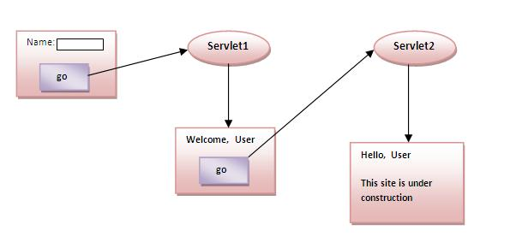

Slide 218
Index.html
<form action="servlet1" method="post">
Name:<input type="text" name="userName"/><br/>
<input type="submit" value="go"/>
</form>

Slide 219
FirstServlet.java
PrintWriter out = response.getWriter();
String n=request.getParameter("userName");
out.print("Welcome "+n);
Cookie ck=new Cookie("uname",n);//creating cookie object
response.addCookie(ck);//adding cookie in the response
//creating submit button
out.print("<form action='servlet2'>");
out.print("<input type='submit' value='go'>");
out.print("</form>");
out.close();

Slide 220
SecondServlet.java
response.setContentType("text/html");
PrintWriter out = response.getWriter();
Cookie ck[]=request.getCookies();
out.print("Hello "+ck[0].getValue());
out.close();

Slide 221
2) Hidden Form Field

Slide 222
Hidden Form Fields
In case of Hidden Form Field a hidden (invisible) textfield is used for maintaining the state of an user.
In such case, we store the information in the hidden field and get it from another servlet. This approach is better if we have to submit form in all the pages and we don't want to depend on the browser.

Slide 223
Code to see value in hidden fields
<input type="hidden" name="uname" value=“Ramu">

Slide 224
Real application of hidden form field
It is widely used in comment form of a website. In such case, we store page id or page name in the hidden field so that each page can be uniquely identified.

Slide 225
Advantage of Hidden Form Field
It will always work whether cookie is disabled or not.

Slide 226
Disadvantage of Hidden Form Field:
It is maintained at server side.
Extra form submission is required on each pages.
Only textual information can be used.

Slide 227
Example of using Hidden Form Field
In this example, we are storing the name of the user in a hidden textfield and getting that value from another servlet.

Slide 228
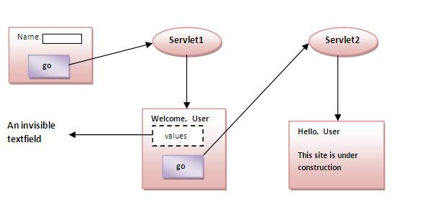

Slide 229
index.html
<form action="servlet1">
Name:<input type="text" name="userName"/><br/>
<input type="submit" value="go"/>
</form>

Slide 230
FirstServlet.java
String n=request.getParameter("userName");
out.print("Welcome "+n);
//creating form that have invisible textfield
out.print("<form action='servlet2'>");
out.print("<input type='hidden' name='uname' value='"+n+"'>");
out.print("<input type='submit' value='go'>");
out.print("</form>");
out.close();

Slide 231
SecondServlet.java
//Getting the value from the hidden field
String n=request.getParameter("uname");
out.print("Hello "+n);

Slide 232
3)URL Rewriting
3)URL Rewriting

Slide 233
URL Rewriting
In URL rewriting, we append a token or identifier to the URL of the next Servlet or the next resource. We can send parameter name/value pairs using the following format:
url?name1=value1&name2=value2&??
A name and a value is separated using an equal = sign, a parameter name/value pair is separated from another parameter using the ampersand(&). When the user clicks the hyperlink, the parameter name/value pairs will be passed to the server. From a Servlet, we can use getParameter() method to obtain a parameter value.

Slide 234
Advantage of URL Rewriting
It will always work whether cookie is disabled or not (browser independent).
Extra form submission is not required on each pages.

Slide 235
Disadvantage of URL Rewriting
It will work only with links.
It can send Only textual information.

Slide 236
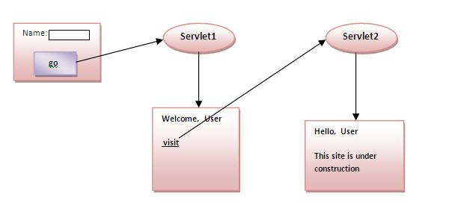
Example of using URL Rewriting

Slide 237
Index.html
<form action="servlet1">
Name:<input type="text" name="userName"/><br/>
<input type="submit" value="go"/>
</form>

Slide 238
FirstServlet.java
String n=request.getParameter("userName");
out.print("Welcome "+n);
//appending the username in the query string
out.print("<a href='servlet2?uname="+n+"'>visit</a>");

Slide 239
SecondServlet.java
//getting value from the query string
String n=request.getParameter("uname");
out.print("Hello "+n);

Slide 240
4) HttpSession interface
4) HttpSession interface

Slide 241
HttpSession
In such case, container creates a session id for each user.The container uses this id to identify the particular user.An object of HttpSession can be used to perform two tasks:
bind objects
view and manipulate information about a session, such as the session identifier, creation time, and last accessed time.

Slide 242
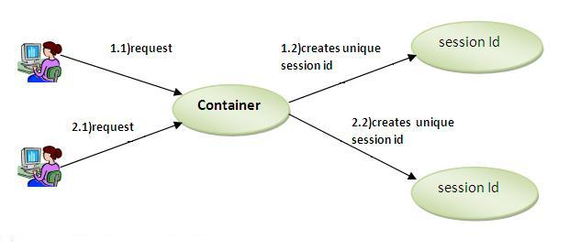

Slide 243
How to get the HttpSession object ?
The HttpServletRequest interface provides two methods to get the object of HttpSession:
public HttpSession getSession():Returns the current session associated with this request, or if the request does not have a session, creates one.
public HttpSession getSession(boolean create):Returns the current HttpSession associated with this request or, if there is no current session and create is true, returns a new session.

Slide 244
Differences among getSession(), getSession(true), and getSession(false);
getSession() --. getSession(true);
getSession(true);
if the session object is already created, it returns the
same object, else it creates new one
getSession(false);
if the session object is already created, it returns the
same object, else it doesn't create new one

Slide 245
Commonly used methods of HttpSession interface
public String getId():Returns a string containing the unique identifier value.
public long getCreationTime():Returns the time when this session was created, measured in milliseconds since midnight January 1, 1970 GMT.
public long getLastAccessedTime():Returns the last time the client sent a request associated with this session, as the number of milliseconds since midnight January 1, 1970 GMT.
public void invalidate():Invalidates this session then unbinds any objects bound to it.

Slide 246
Example of using HttpSession
In this example, we are setting the attribute in the session scope in one servlet and getting that value from the session scope in another servlet. To set the attribute in the session scope, we have used the setAttribute() method of HttpSession interface and to get the attribute, we have used the getAttribute method.

Slide 247
index.html
<form action="servlet1">
Name:<input type="text" name="userName"/><br/>
<input type="submit" value="go"/>
</form>

Slide 248
FirstServlet.java
String n=request.getParameter("userName");
out.print("Welcome "+n);
HttpSession session=request.getSession();
session.setAttribute("uname",n);
out.print("<a href='servlet2'>visit</a>");

Slide 249
SecondServlet.java
HttpSession session=request.getSession(false);
String n=(String)session.getAttribute("uname");
out.print("Hello "+n);

Slide 250
Servlet Filter

Slide 251
Servlet Filter
A filter is an object that is invoked at the preprocessing and postprocessing of a request.
It is mainly used to perform filtering tasks such as conversion, logging, compression, encryption and decryption, input validation etc.
The servlet filter is pluggable, i.e. its entry is defined in the web.xml file, if we remove the entry of filter from the web.xml file, filter will be removed automatically and we don't need to change the servlet.
So maintenance cost will be less.

Slide 252
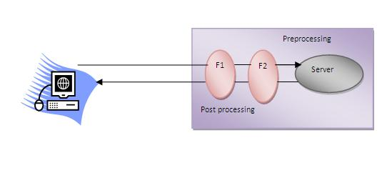
Servlet Filter Flow

Slide 253
Note
Unlike Servlet, One filter doesn't have dependency on another filter.

Slide 254
Usage of Filter
recording all incoming requests
logs the IP addresses of the computers from which the requests originate
conversion
data compression
encryption and decryption
input validation etc.

Slide 255
Advantage of Filter
Filter is pluggable.
One filter don't have dependency onto another resource.
Less Maintenance

Slide 256
Filter API
The javax.servlet package contains the three interfaces of Filter API.
Filter
FilterChain
FilterConfig

Slide 257
1) Filter interface
For creating any filter, you must implement the Filter interface. Filter interface provides the life cycle methods for a filter.
Method | Description
public void init(FilterConfig config) | init() method is invoked only once. It is used to initialize the filter.
public void doFilter(HttpServletRequest request,HttpServletResponse response, FilterChain chain) | doFilter() method is invoked every time when user request to any resource, to which the filter is mapped.It is used to perform filtering tasks.
public void destroy() | This is invoked only once when filter is taken out of the service.

Slide 258
2) FilterChain interface
The object of FilterChain is responsible to invoke the next filter or resource in the chain.This object is passed in the doFilter method of Filter interface.The FilterChain interface contains only one method:
public void doFilter(HttpServletRequest request, HttpServletResponse response): it passes the control to the next filter or resource.

Slide 259
How to define Filter We can define filter same as Servlet
<web-app>
<filter>
<filter-name>...</filter-name>
<filter-class>...</filter-class>
</filter>
<filter-mapping>
<filter-name>...</filter-name>
<url-pattern>...</url-pattern>
</filter-mapping>
</web-app>

Slide 260
Note
For mapping filter we can use, either url-pattern or servlet-name. The url-pattern elements has an advantage over servlet-name element i.e. it can be applied on servlet, JSP or HTML.

Slide 261
Simple Example of Filter
In this example, we are simply displaying information that filter is invoked automatically after the post processing of the request.

Slide 262
index.html
<a href="servlet1">click here</a>

Slide 263
MyFilter.java
public class MyFilter implements Filter{
public void init(FilterConfig arg0) throws ServletException {}
public void doFilter(ServletRequest req, ServletResponse resp,
FilterChain chain) throws IOException, ServletException {
PrintWriter out=resp.getWriter();
out.print("filter is invoked before");
chain.doFilter(req, resp);//sends request to next resource
out.print("filter is invoked after");
}
public void destroy() {}
}

Slide 264
HelloServlet.java
public class HelloServlet extends HttpServlet {
public void doGet(HttpServletRequest request, HttpServletResponse response)
throws ServletException, IOException {
response.setContentType("text/html");
PrintWriter out = response.getWriter();
out.print("<br>welcome to servlet<br>");
}

Slide 265
web.xml
<servlet>
<servlet-name>s1</servlet-name>
<servlet-class>HelloServlet</servlet-class>
</servlet>
<servlet-mapping>
<servlet-name>s1</servlet-name>
<url-pattern>/servlet1</url-pattern>
</servlet-mapping>
<filter>
<filter-name>f1</filter-name>
<filter-class>MyFilter</filter-class>
</filter>
<filter-mapping>
<filter-name>f1</filter-name>
<url-pattern>/servlet1</url-pattern>
</filter-mapping>

Slide 266
Useful Filter Examples

Slide 267
Example of sending response by filter only
public class MyFilter implements Filter {
public void init(FilterConfig arg0) throws ServletException {
}
public void doFilter(ServletRequest req, ServletResponse res,
FilterChain chain) throws IOException, ServletException {
PrintWriter out = res.getWriter();
out.print("<br/>this site is underconstruction..");
out.close();
}
public void destroy() {
}
}

Slide 268
Example of counting number of visitors for a single page
public class MyFilter implements Filter {
static int count = 0;
public void init(FilterConfig arg0) throws ServletException {
}
public void doFilter(ServletRequest req, ServletResponse res,
FilterChain chain) throws IOException, ServletException {
PrintWriter out = res.getWriter();
chain.doFilter(request, response);
out.print("<br/>Total visitors " + (++count));
out.close();
}
public void destroy() {
}
}

Slide 269
Example of checking total response time in filter
public class MyFilter implements Filter {
static int count = 0;
public void init(FilterConfig arg0) throws ServletException {
}
public void doFilter(ServletRequest req, ServletResponse res,
FilterChain chain) throws IOException, ServletException {
PrintWriter out = res.getWriter();
long before = System.currentTimeMillis();
chain.doFilter(request, response);
long after = System.currentTimeMillis();
out.print("<br/>Total response time " + (after - before)
+ " miliseconds");
out.close();
}
public void destroy() {
}
}

Slide 270
ServletInputStream and ServletOutputStream classes

Slide 271
ServletInputStream
ServletInputStream class provides stream to read binary data such as image etc. from the request object. It is an abstract class.
The getInputStream() method of ServletRequest interface returns the instance of ServletInputStream class.
EX:
ServletInputStream sin=request.getInputStream();

Slide 272
Method of ServletInputStream class
There is only one method defined in the ServletInputStream class.
int readLine(byte[] b, int off, int len) it reads the input stream.

Slide 273
ServletOutputStream class
ServletOutputStream class provides a stream to write binary data into the response. It is an abstract class.
The getOutputStream() method of ServletResponse interface returns the instance of ServletOutputStream class
ServletOutputStream out=response.getOutputStream();

Slide 274
Methods of ServletOutputStream class
The ServletOutputStream class provides print() and println() methods that are overloaded.
void print(boolean b){}
void print(char c){}
void print(int i){}
void print(long l){}
void print(float f){}
void print(double d){}
void print(String s){}
void println{}
void println(boolean b){}
void println(char c){}
void println(int i){}
void println(long l){}
void println(float f){}
void println(double d){}
void println(String s){}

Slide 275
Example of ServletOutputStream class to write image

Slide 276
Example to write image
In this example, we are using FileInputStream class to read image and ServletOutputStream class for writing this image content as a response. To make the performance faster, we have used BufferedInputStream and BufferedOutputStream class.
You need to use the content type image/jpeg.
In this example, we are assuming that you have java.jpg image inside the c:\test directory. You may change the location accordingly.

Slide 277
File Names
index.html
DisplayImage.java
web.xml

Slide 278
index.html
<a href="servlet1">click for photo</a>

Slide 279
DisplayImage.java
This servlet class reads the image from the mentioned directory and writes the content in the response object using ServletOutputStream and BufferedOutputStream classes.

Slide 280
DisplayImage.java
public class DisplayImage extends HttpServlet {
public void doGet(HttpServletRequest request,HttpServletResponse response)
throws IOException
{
response.setContentType("image/jpeg");
ServletOutputStream out;
out = response.getOutputStream();
FileInputStream fin = new FileInputStream("c:\\test\\java.jpg");
BufferedInputStream bin = new BufferedInputStream(fin);
BufferedOutputStream bout = new BufferedOutputStream(out);
int ch =0; ;
while((ch=bin.read())!=-1)
{
bout.write(ch);
}
bin.close();
fin.close();
bout.close();
out.close();
}

Slide 281
What is difference between PrintWriter and ServletOutputStream?
PrintWriter is a character-stream class whereas ServletOutputStream is a byte-stream class. We can use PrintWriter to write character based information such as character array and String to the response whereas we can use ServletOutputStream to write byte array data to the response.
We can use ServletResponse getWriter() to get the PrintWriter instance whereas we can use ServletResponse getOutputStream() method to get the ServletOutputStream object reference.

Slide 282
Can we get PrintWriter and ServletOutputStream both in a servlet?
We can’t get instances of both PrintWriter and ServletOutputStream in a single servlet method, if we invoke both the methods; getWriter() and getOutputStream() on response; we will get java.lang.IllegalStateException at runtime with message as other method has already been called for this response.

Slide 283
What are important features of Servlet 3?
Servlet Specs 3.0 was a major release and some of the important features are:
Servlet Annotations: Prior to Servlet 3, all the servlet mapping and it’s init parameters were used to defined in web.xml, this was not convenient and more error prone when number of servlets are huge in an application.Servlet 3 introduced use of java annotations to define a servlet, filter and listener servlets and init parameters. Some of the important Servlet API annotations are WebServlet, WebInitParam, WebFilter and WebListener. Read more about them at Servlet 3 annotations.
Web Fragments: Prior to servlet specs 3.0, all the web application configurations are required to be present in the web.xml that makes it cluttered with lot of elements and chances of error increases. So servlet 3 specs introduced web fragments where we can have multiple modules in a single web application, all these modules should have web-fragment.xml file in META-INF directory. We can include all the elements of web.xml inside the web-fragment.xml too. This helps us in dividing our web application into separate modules that are included as JAR file in the web application lib directory.
Adding Web Components dynamically: We can use ServletContext object to add servlets, filters and listeners programmatically. This helps us in building dynamic system where we are loading a component only if we need it. These methods are addServlet(), addFilter() and addListener() defined in the servlet context object.
Asynchronous Processing: Asynchronous support was added to delegate the request processing to another thread rather than keeping the servlet thread busy. It can increase the throughput performance of the application. This is an advance topic and I recommend to read Async Servlet tutorial.

Slide 284
Servlet with Annotation (feature of servlet3):

Slide 285
Servlet Annotation
Annotation represents the metadata. If you use annotation, deployment descriptor (web.xml file) is not required. But you should have tomcat7 as it will not run in the previous versions of tomcat. @WebServlet annotation is used to map the servlet with the specified name.

Slide 286
Example of simple servlet by annotation
@WebServlet("/Simple")
public class Simple extends HttpServlet {
private static final long serialVersionUID = 1L;
protected void doGet(HttpServletRequest request, HttpServletResponse response)
throws ServletException, IOException {
response.setContentType("text/html");
PrintWriter out=response.getWriter();
out.print("<html><body>");
out.print("<h3>Hello Servlet</h3>");
out.print("</body></html>");
}
}

Slide 287
Java Servlet Tip:
Use an empty URL mapping for a "home servlet" that is called only when the home page URL is accessed. For example:
@WebServlet("") public class HomeServlet extends HttpServlet{
}

Slide 288
SingleThreadModel interface

Slide 289
SingleThreadModel interface
The servlet programmer should implement SingleThreadModel interface to ensure that servlet can handle only one request at a time. It is a marker interface, means have no methods.
This interface is currently deprecated since Servlet API 2.4 because it doesn't solves all the thread-safety issues such as static variable and session attributes can be accessed by multiple threads at the same time even if we have implemented the SingleThreadModel interface. So it is recommended to use other means to resolve these thread safety issues such as synchronized block etc.

Slide 290
Example of SingleThreadModel interface
public void doGet(HttpServletRequest request, HttpServletResponse response)
throws ServletException, IOException {
response.setContentType("text/html");
PrintWriter out = response.getWriter();
out.print("welcome");
try{Thread.sleep(10000);}catch(Exception e){e.printStackTrace();}
out.print(" to servlet");
out.close();
}
}

Slide 291
if we have implemented single thread means only one instance is going handle one request at a time no two thread will concurrently execute service method of the servlet.
if we have implemented single thread means only one instance is going handle one request at a time no two thread will concurrently execute service method of the servlet.

Slide 292
How can we create deadlock condition on our servlet?
Ans: one simple way to call doPost() method inside doGet() and doGet()method inside doPost() it will create deadlock situation for a servlet.

Slide 293
How can we achieve transport layer security for our web application?
We can configure our servlet container to use SSL for message communication over the network. To configure SSL on Tomcat, we need a digital certificate that can be created using Java keytool for development environment. For production environment, you should get the digital certificate from SSL certificate providers, for example, Verisign or Entrust.

Slide 294
Steps to Configure SSL on Tomcat and Setup Auto Redirect from HTTP to HTTPS
Secured Socket Layer (SSL) is the cryptography protocol to provide message security over the internet. It works on the notion of Private and Public keys and messages are encrypted before sending it over the network. To configure SSL on Tomcat, we need a digital certificate that can be created using Java keytool for development environment. For production environment, you should get the digital certificate from SSL certificate providers, for example, Verisign or Entrust.
Follow below steps

Slide 295
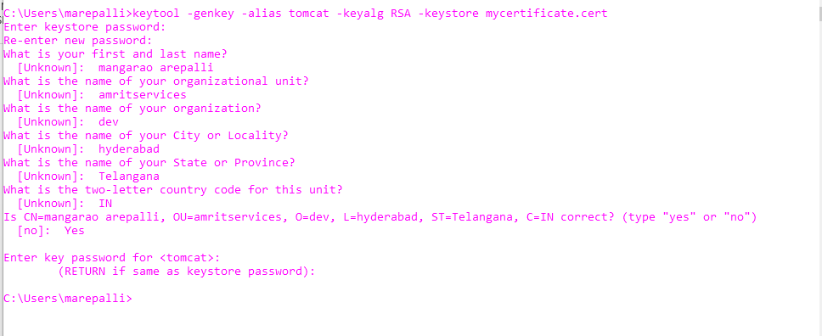
1. Create Digital certificate I have entered password “password” for keystore and key but you can use whatever you want.

Slide 296
Now our digital certificate is ready and next step is to enable HTTPS communication port in tomcat and set it to use our digital certificate for providing SSL support.

Slide 297
2) Tomcat HTTPS – Enable HTTPS
To enable SSL open ~Tomcat_Installation/conf/server.xml file and uncomment following line:
<Connector port="8443" maxHttpHeaderSize="8192"
maxThreads="150" minSpareThreads="25" maxSpareThreads="75"
enableLookups="false" disableUploadTimeout="true"
acceptCount="100" scheme="https" secure="true"
keystoreFile="/Users/manga/tomcat/conf/mycertificate.cert"
clientAuth="false" sslProtocol="TLS" />
Note: keystoreFile – mention path of the digital certificate file

Slide 298
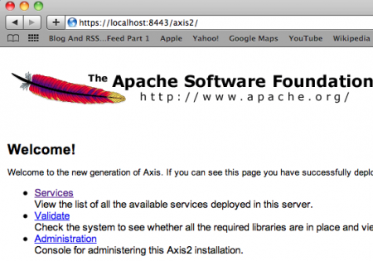
Now restart tomcat and try to access any web application over https with port 8443.

Slide 299
Tomcat Redirect HTTP to HTTPS
So we can access any web application on both HTTP and HTTPS ports. We can set up tomcat to redirect all HTTP request to HTTPS port with some configurations.
1) In ~TomcatInstallation/conf/server.xmlFor HTTP Connector, set the redirect port to the HTTPS connector port. It will look somewhat like this:
<!-- Define a non-SSL HTTP/1.1 Connector on port 8080 -->
<Connector port="8090" maxHttpHeaderSize="8192"
maxThreads="150" minSpareThreads="25" maxSpareThreads="75"
enableLookups="false" redirectPort="8443" acceptCount="100"
connectionTimeout="20000" disableUploadTimeout="true" />

Slide 300
2) In ~TomcatInstallation/conf/web.xmlAdd below configuration but make sure to add it after all the servlet mapping tags.
<security-constraint>
<web-resource-collection>
<web-resource-name>Entire Application</web-resource-name>
<url-pattern>/*</url-pattern>
</web-resource-collection>
<user-data-constraint>
<transport-guarantee>CONFIDENTIAL</transport-guarantee>
</user-data-constraint>
</security-constraint>

Slide 301
Restart the tomcat now and all the HTTP requests will automatically be redirected to HTTPS i.e http://localhost:8080/axis2 will be automatically redirected to https://localhost:8443/axis2
Note: If you don’t want to provide ports in the URLs, then use 80 for HTTP and 443 for HTTPS and in this case you can skip the first step to automatic redirect HTTP requests to HTTPS because it will automatically pick the default port 443.

Slide 302
How can we refresh servlet on client and server side automatically?
On the client side we can use Meta HTTP refresh and server side we can use server push.

